Slide 1
Bubble Sort and Quick-sort
EECS 233

Slide 2
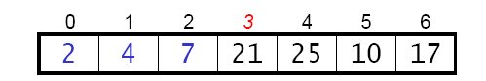
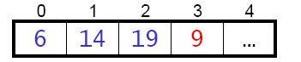
Recap
Method 1: Selection Sort
  For each position of an array, find the element for it
  O(n²) comparisons, O(n) moves
Method 2: Insertion Sort
  For each element, find a position to insert it
  O(n²) comparisons, O(n²) moves
  O(n) if the array is sorted or nearly sorted
Method 3: Shell Sort
  Based on the observation that insertion sort requires O(n) running time for sorted or nearly sorted array
  Generalization of insertion sort with larger “jumps”, using strides larger than 1 (for insertion sort, the stride = 1)
  Use a decreasing sequence of strides
0 1 2 3 4 5 6 7 8
99 8 13 2 15 9 4 12 24

Slide 3
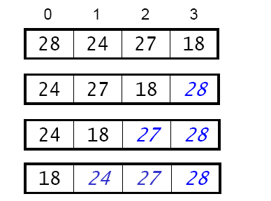
Method 4: Bubble Sort
Perform a sequence of passes through the array.
On each pass: proceed from left to right, swapping adjacent elements if they are out of order. Larger elements “bubble up” to the end of the array.
At the end of the kth pass, the k rightmost elements are in their final positions.
Example:
  After one pass
  After two passes
  After three passes

Slide 4
Implementation of Bubble Sort
  static void bubbleSort(int[] arr) {
    for (int i = arr.length – 1; i > 0; i--) {
      for (int j = 0; j < i; j++) {
        if (arr[j] > arr[j+1])
        swap(arr, j, j+1);
      }
    }
  }
The inner loop performs a single pass
The outer loop governs the number of passes, and the ending point of each pass

Slide 5
Running Time Analysis
  static void bubbleSort(int[] arr, int n) {
    for (int i = n – 1; i > 0; i--) {
      for (int j = 0; j < i; j++) {
        if (arr[j] > arr[j+1])
        swap(arr, j, j+1);
      }
    }
  }
Number of comparisons
  the k-th pass performs ? comparisons, k=1,2,…,n-1
  so we get C(n) = ?
Moves: depends on the contents of the array
  in the worst case: the array is in reverse order, and every comparison leads to a swap (3 moves), so M(n) = ?
  in the best case: the array is already sorted, and no moves are needed
  Average: 50% chance a comparison leads to a swap
Total running time: ?
  C(n) is always O(n²), M(n) is never worse than O(n²).
n-k
(n-1) + (n-2) + … + 1 = n²/2-n/2 = O(n²)
3C(n) = O(n²)
  O(n²)

Slide 6
Method 5: Quick-Sort
0 1 2 3 4 5 6 7 8
    99 8 13 2 15 9 4 12 24
Like bubble sort, quick-sort uses an approach based on exchanging out-of-place elements, but it’s more efficient. Analogy:
  Insertion sort to Shell sort: jump faster
  Bubble sort to quick sort: bubble faster
A divide-and-conquer method:
  divide: rearrange the elements so that we end up with two sub-arrays such that: each element in the left array <= each element in the right array
    example:
16 8 13 2 15 9 4 12 24 4 8 9 2 15 13 16 12 24
  conquer: sort both sub-arrays (apply quick-sort recursively to the sub-arrays, stopping when a sub-array has a single element)
  combine: nothing needs to be done, because of the criterion used in forming the subarrays
0 1 2 3 4 5 6 7 8
0 1 2 3 4 5 6 7 8

Slide 7
Partitioning An Array
The process that quick-sort uses to rearrange the elements is known as partitioning the array.
Partitioning is done using a value known as the pivot. We rearrange the elements to produce two subarrays:
  left subarray: all values <= pivot
  right subarray: all values >= pivot
16 8 13 2 15 9 4 12 24
Using pivot = 9
4 8 9 2 15 13 16 12 24
All elements <= 9 all elements >= 9
0 1 2 3 4 5 6 7 8
0 1 2 3 4 5 6 7 8

Slide 8
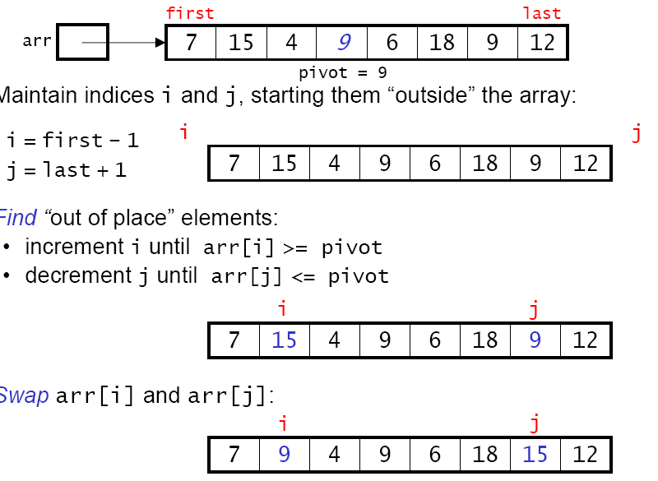
An Example of Partitioning An Array
Pivot = middle element
Maintain indices i and j, starting them “outside” the array:
Find “out-of-place” elements:
  increment i until arr[i] >= pivot
  decrement j until arr[j] <= pivot
Swap arr[i] and arr[j] if necessary

Slide 9
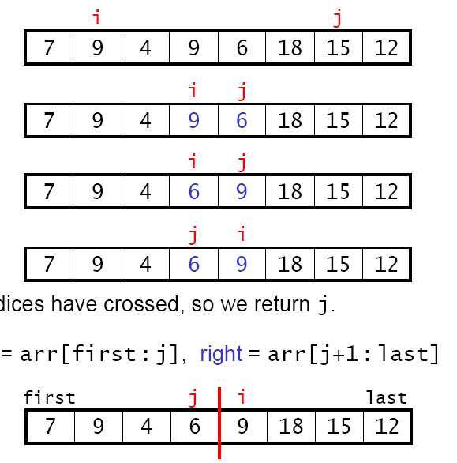
Partitioning An Array
From previous slide
Advance i and j
Need to swap
i and j cross
Return j, indicating two subarrays: arr[first : j] and arr[j+1 : last]

Slide 10
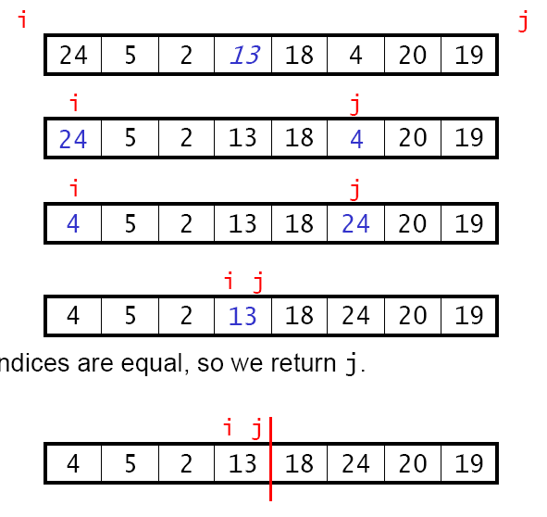
Another Example
Choose pivot=13
Advance i and j
Swap 4 and 24
i and j meet
Return j and we have two subarrays: arr[first : j] and arr[j+1 : last]

Slide 11
An exercise
i
j
0 1 2 3 4 5 6 7 8
16
8
13
2
9
15
4
12
24

Slide 12
Implementation of Quick-Sort
  static void quickSort(int[] arr) {
    myQuickSort(arr, 0, arr.length – 1);
  }
  static void myQuickSort(int[] arr, int first, int last) {
  if (first >= last) return;
    int split = partition(arr, first, last);
    ?
  }
quickSort() is the method provided by the Sort class, which calls a recursive method myQuickSort
The recursive method myQuickSort() stops when the subarray size is 1

Slide 13
Implementation of Quick-Sort
The helper method partition()
  static int partition(int[] arr, int first, int last)
  {
    int pivot = arr[(first + last)/2];
    int i = first - 1; // index going from left to right
    int j = last + 1; // index going from right to left
    while (true) {
      ?
    }
  }

Slide 14
Implementation of Quick-Sort
The helper method partition()
  static int partition(int[] arr, int first, int last)
  {
    int pivot = arr[(first + last)/2];
    int i = first - 1; // index going from left to right
    int j = last + 1; // index going from right to left
    while (true) {
      do {
        i++;
      } while (arr[i] < pivot);
      do {
        j--;
      } while (arr[j] > pivot);
      if (i < j)
        swap(arr, i, j);
      else
        return j; // arr[j] = end of left array
    }
  }
Why not this?
  static int partition(int[] arr, int first, int last)
  {
    int pivot = arr[(first + last)/2];
    int i = first;
    int j = last;
    while (true) {
      while (arr[i] < pivot)
        i++;
      while (arr[j] > pivot);
        j--;
      if (i < j)
        swap(arr, i, j);
      else
        return j; // arr[j] = end of left array
    }
  }

Slide 15
Implementation of Quick-Sort
The helper method partition()
  static int partition(int[] arr, int first, int last)
  {
    int pivot = arr[(first + last)/2];
    int i = first - 1; // index going left to right
    int j = last + 1; // index going right to left
    while (true) {
      do {
        i++;
      } while (arr[i] < pivot);
      do {
        j--;
      } while (arr[j] > pivot);
      if (i < j)
        swap(arr, i, j);
      else
        return j; // arr[j] = end of left array
    }
  }
Why not this?
  static int partition(int[] arr, int first, int last)
  {
    int pivot = arr[(first + last)/2];
    int i = first;
    int j = last;
    while (true) {
      while (arr[i] < pivot)
        i++;
      while (arr[j] > pivot);
        j--;
      if (i < j)
        swap(arr, i, j);
      else
        return j; // arr[j] = end of left array
    }
  }

Slide 16
Choosing Pivot Values (for Partitioning)
First element or last element
  risky, can lead to terrible worst-case behavior
  especially poor if the array is almost sorted
16 8 13 2 15 9 4 12 24 16 8 13 2 15 9 4 12 24
Middle element (good if the array is sorted)
Randomly chosen element
Median of three elements: to decrease the probability of getting a poor pivot
  left, center, and right elements
  three randomly selected elements
0 1 2 3 4 5 6 7 8
0 1 2 3 4 5 6 7 8

Slide 17
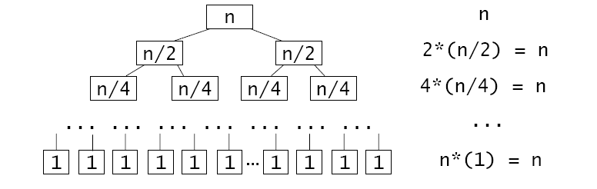
Running Time Analysis - Best Case
Partitioning an array requires n comparisons, because each element is compared with the pivot.
best case: partitioning always divides the array in half
    recursive call tree for qSort() # comparisons
  at each level of the call tree, we perform n comparisons
  There are log₂n levels in the tree. So C(n) = nlog₂n = O(nlog n)
  Similarly, M(n) and running time are both O(nlog n)

Slide 18
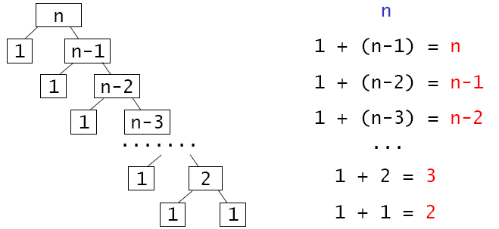
Running Time Analysis - Worst Case
Worst case: pivot is always the smallest or largest element one subarray has 1 element, the other has n - 1
  call tree for qSort # comparisons
  C(n) is on the order of O(n²). What is M(n)?
Average case: is harder to analyze. C(n) is still O(nlog n)

